Slide 1
The Search for Intergalactic Globular Clusters
Andres Jaramillo
Mentors
Professor Dennis Zaritsky
Steward Observatory
Postdoc Huanian Zhang
Steward Observatory
Arizona Space Grant Symposium 2019 Tempe, AZ

Slide 2
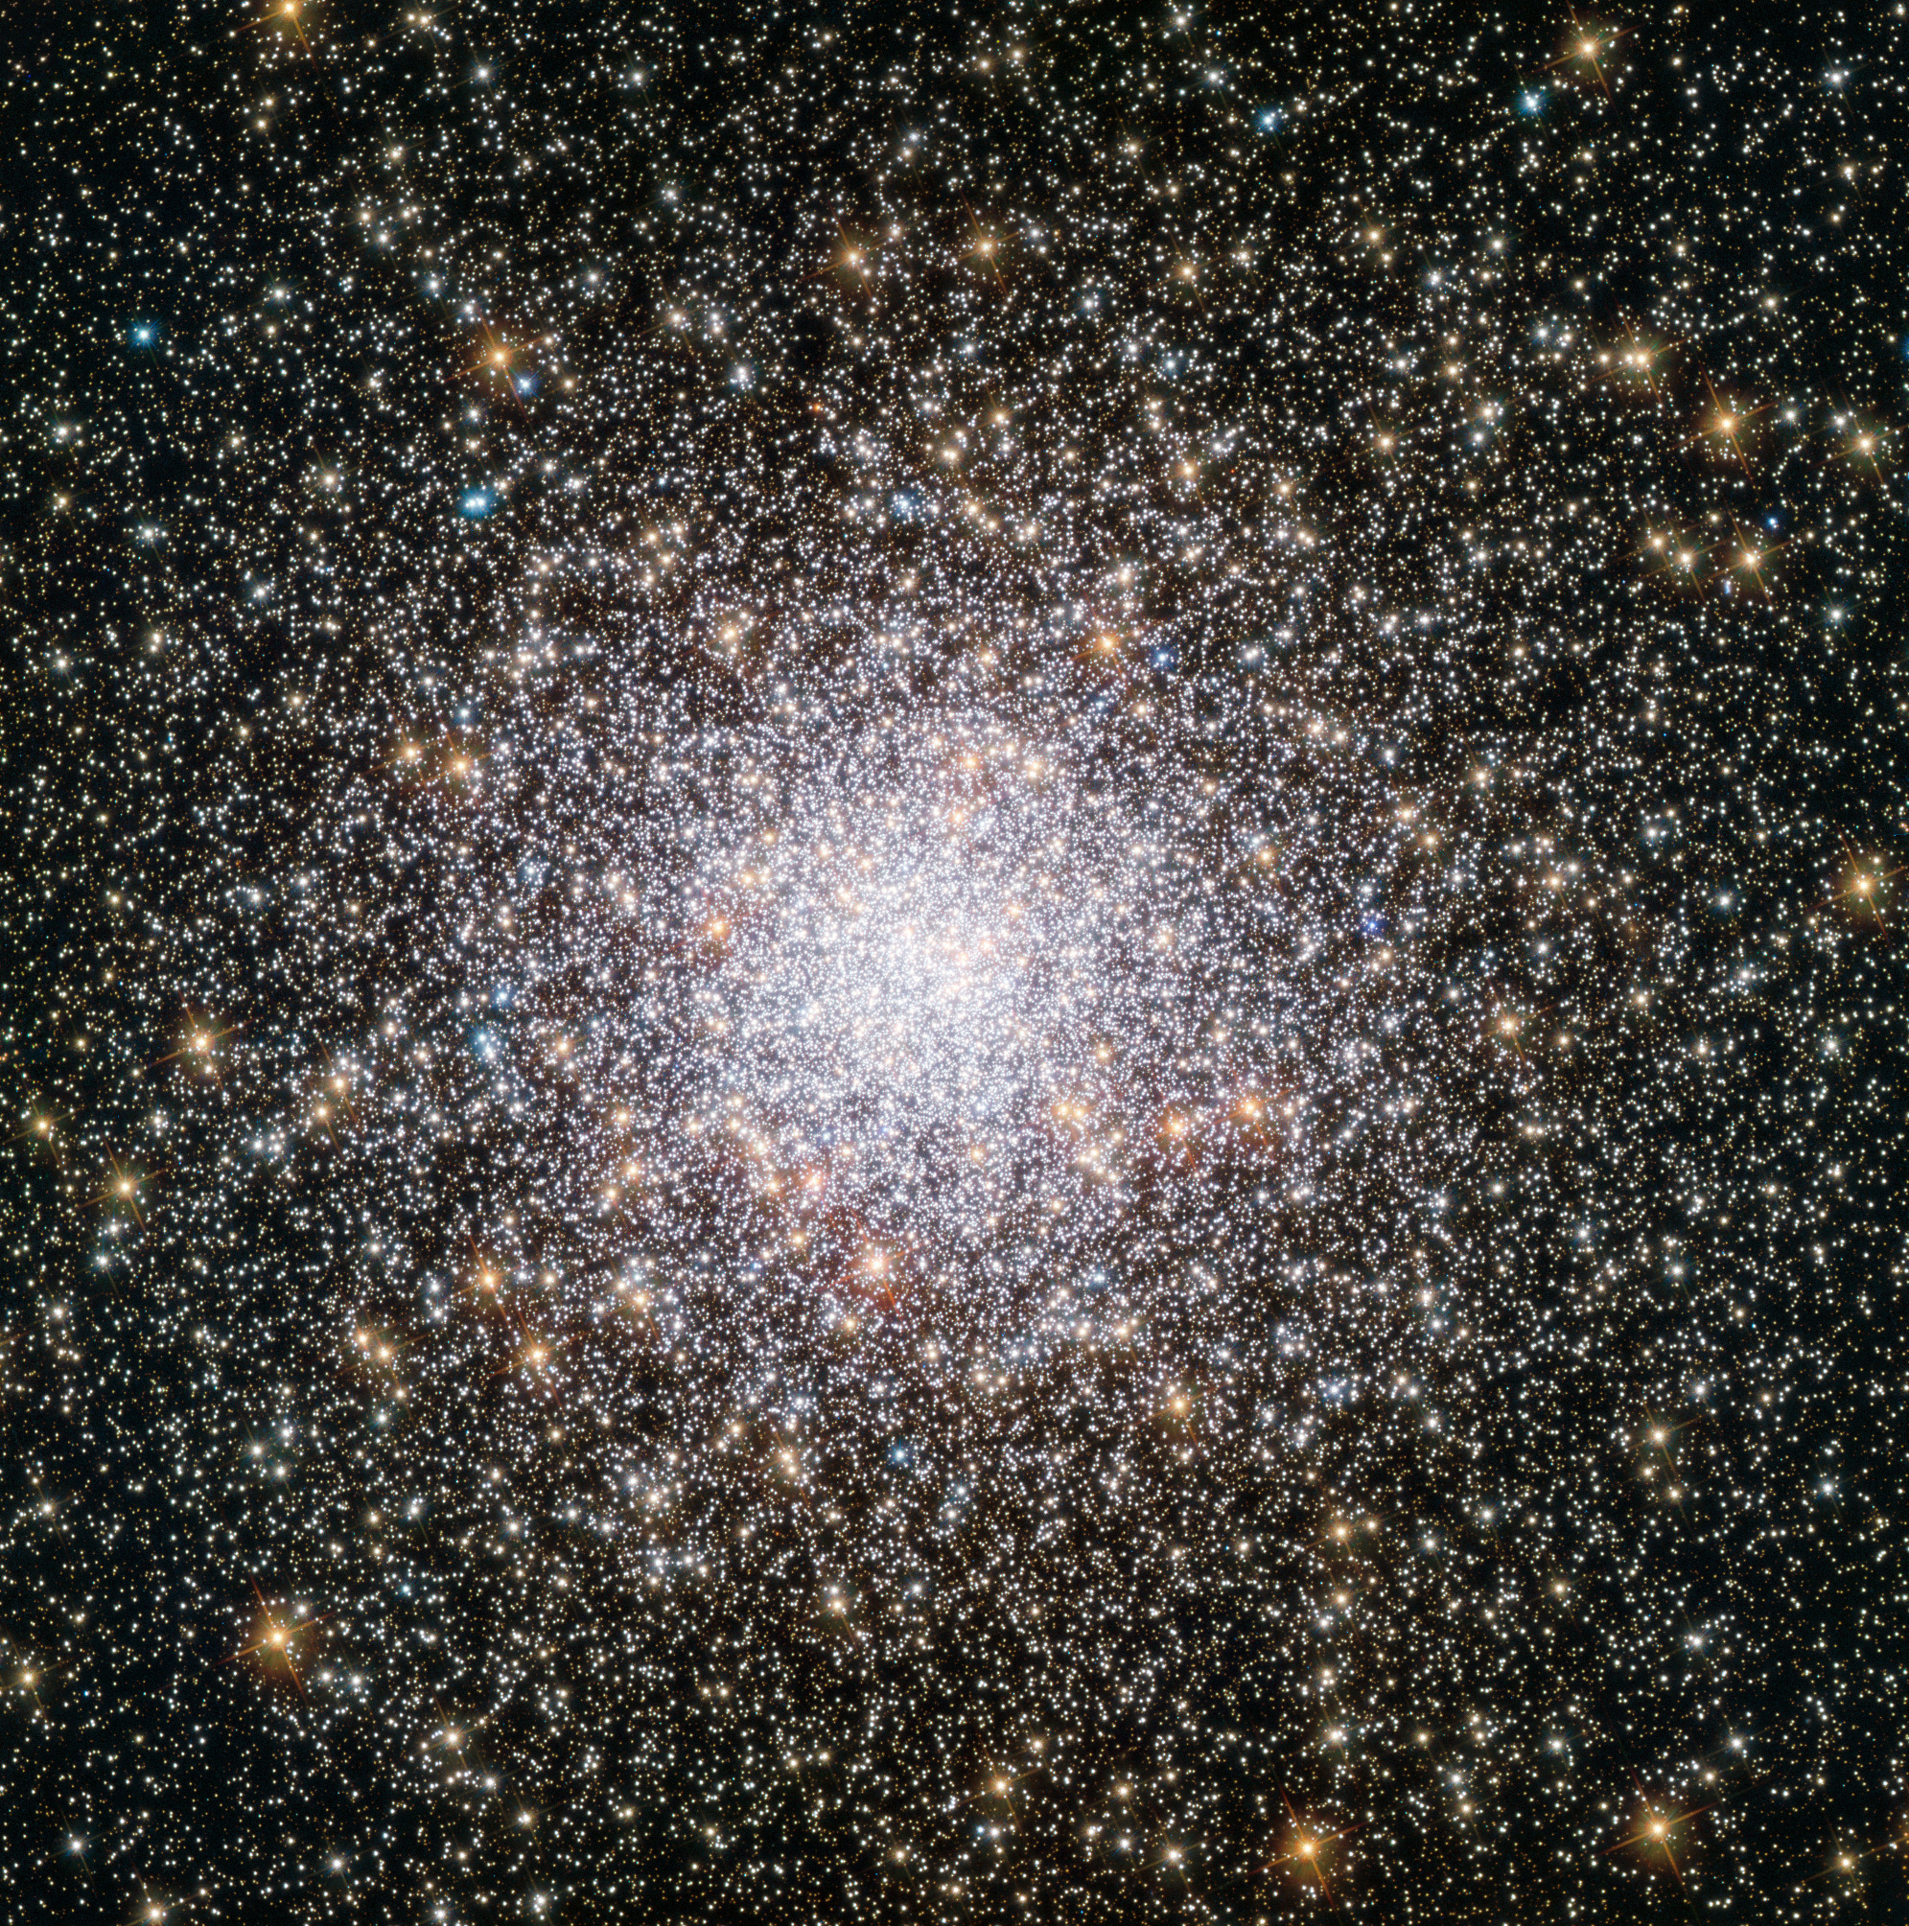
Globular Clusters
(GCs)
Spherical star cluster composed of old stars
Orbit galaxies
Number of GCs linked to total mass of galaxy

Slide 3
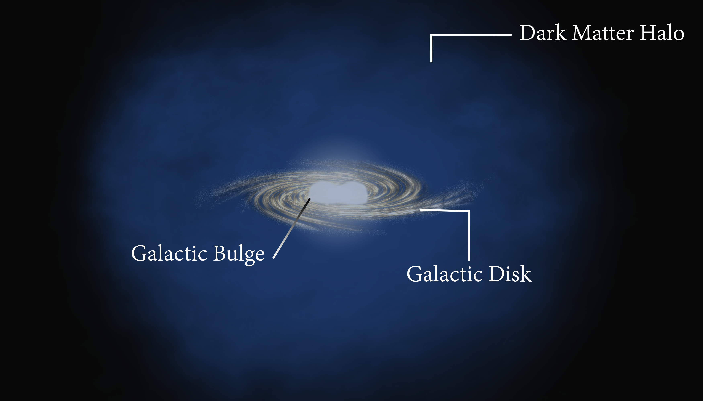
Dark Matter Halos
Accounts for most of a galaxy’s mass
Cannot be detected directly
Contains globular clusters

Slide 4
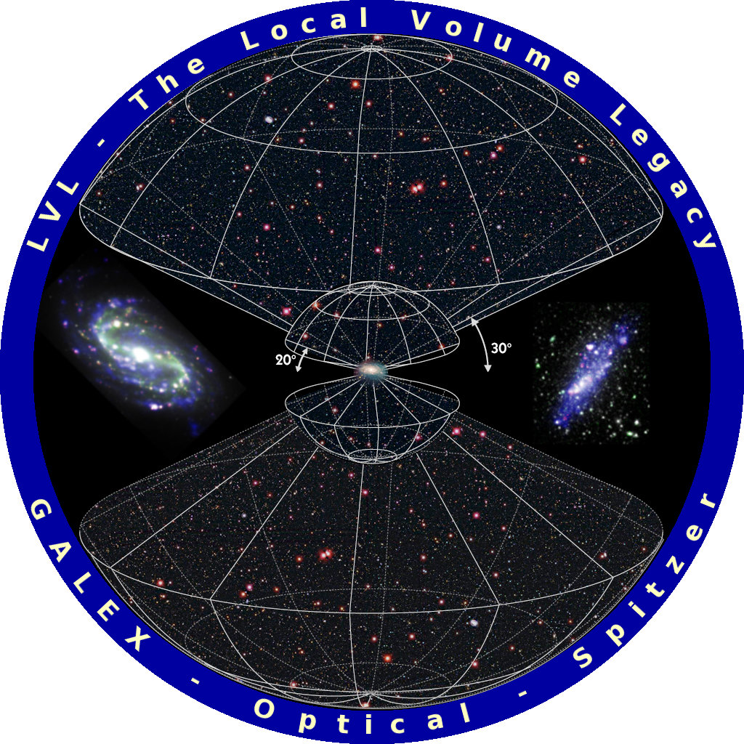
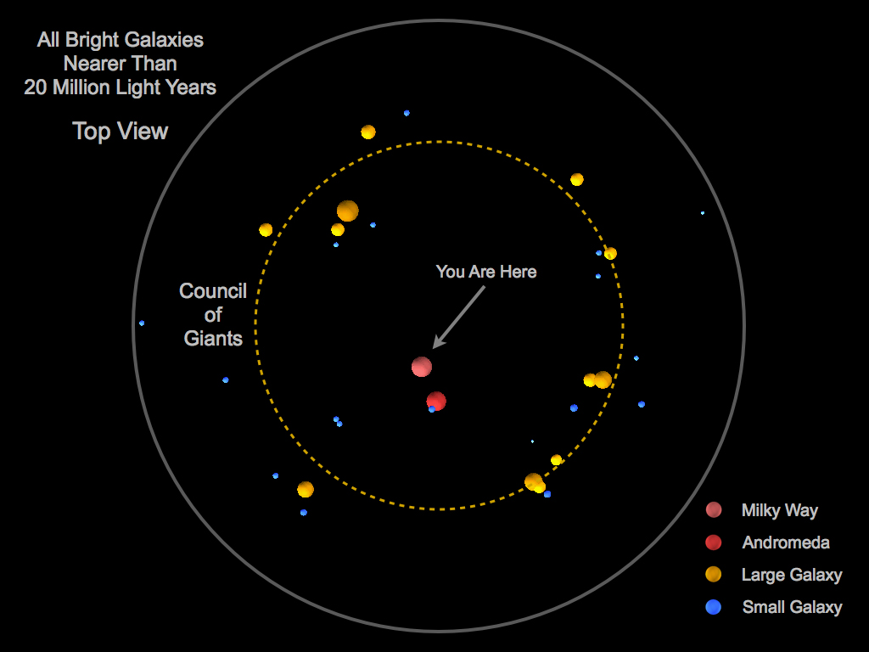
Local Volume

Slide 5
Project Motivation
GCs may be the key to finding dim, dark matter-dominated galaxies
Need a way to differentiate between background galaxies and Local Volume GCs

Slide 6
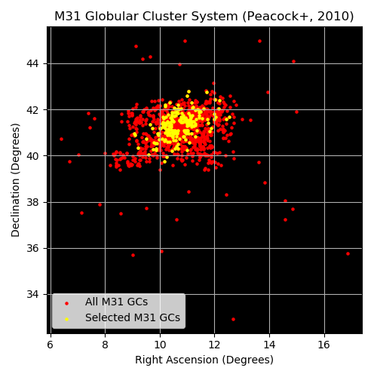
Creating a Training Sample
Selected a small (~300) sample size of globular clusters from an already small (~1500) population

Slide 7
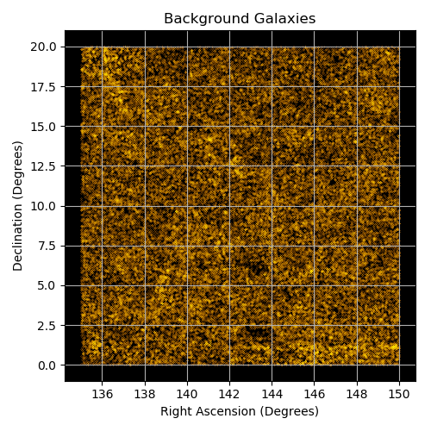
Creating a Training Sample
Gathered a large (~80,000) sample size of galaxies
Far more galaxies than GCs

Slide 8
Simulating Globular Clusters
Starburst99 – Legacy simulation software; simulates stellar populations based on given parameters
SLUG (Stochastically Lighting Up Galaxies) – Simulates GCs and even galaxies to a higher degree of fidelity; resource intensive

Slide 9
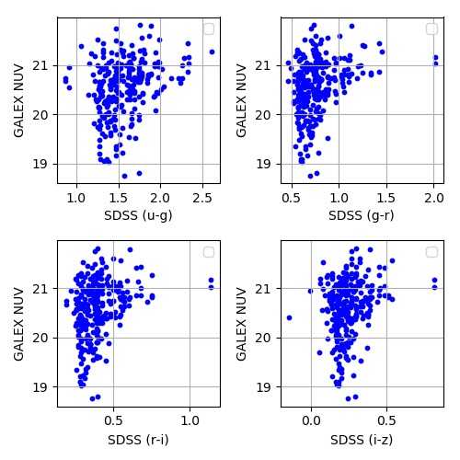
Generating Artificial Globular Clusters
Use color comparisons to differentiate galaxies from GCs
Used GALEX, SDSS, and WISE

Slide 10
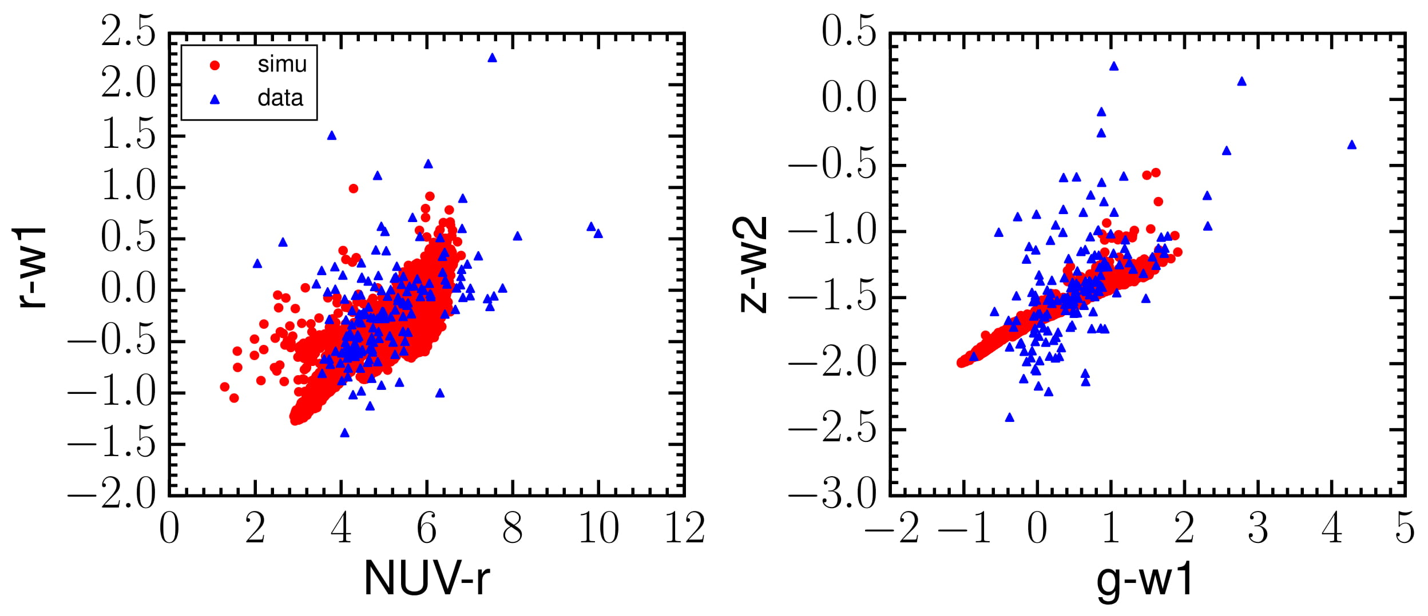
SLUG GCs compared to M31 GCs
Courtesy of Huanian Zhang

Slide 11
Future Work
Apply training sample to sorting algorithm using machine learning
Sort through candidate list and identify probable targets

Slide 12
Thank you!

Slide 13
References
“Hubble Reveals NGC 362, a Young Globular Cluster.” Astronomy Now, astronomynow.com/2016/10/24/hubble-reveals-ngc-362-a-young-globular-cluster/.
Macias, Oscar. “Mysterious Signal Comes from Very Old Stars at the Centre of the Milky Way.” Nature News, Nature Publishing Group, astronomycommunity.nature.com/users/86773-oscar-macias/.
Cook, David O. Caltech, www.astro.caltech.edu/~dcook/research/.

